Slide 1
R Workshop – Day 3
Randi L. Garcia
Smith College
July 17th, 19th, and 21st

Slide 2
Day 3
Multilevel Modeling
Growth Curve Modeling
Dyadic Data Analysis

Slide 3
Definitions: Distinguishability
Can all dyad members be distinguished from one another based on a meaningful factor?
Distinguishable dyads
Gender in heterosexual couples
Patient and caregiver
Race in mixed race dyads

Slide 4
All or Nothing
If most dyad members can be distinguished by a variable (e.g., gender), but a few cannot, then can we say that the dyad members are distinguishable?
No, we cannot!
4

Slide 5
Indistinguishability
There is no systematic or meaningful way to order the two scores
Examples of indistinguishable dyads
Same-sex couples
Twins
Same-gender friends
Mix of same-sex and heterosexual couples
When all dyads are hetero except for even one couple!

Slide 6
It can be complicated…
Distinguishability is a mix of theoretical and empirical considerations.
For dyads to be considered distinguishable:
It should be theoretically important to make such a distinction between members.
Also it should be shown that empirically there are differences.
Sometimes there can be two variables that can be used to distinguish dyad members: Spouse vs. patient; husband vs. wife.
6

Slide 7
Types of Variables
Between Dyads
Variable varies from dyad to dyad, BUT within each dyad all individuals have the same score
Example: Length of relationship
Called a level 2, or macro variable in multilevel modeling

Slide 8
A
A
A
B
A
B
B
A
A
B
Between

Slide 9
Within Dyads
Variable varies from person to person within a dyad, BUT there is no variation on the dyad average from dyad to dyad.
Percent time talking in a dyad
Reward allocation if each dyad is assigned the same total amount
X1 + X2 equals the same value for each dyad
Note: If in the data, there is a dichotomous within-dyads variable, then dyad members can be distinguished on that variable. But that doesn’t mean it would be theoretically meaningful to do so.

Slide 10
B
B
A
B
A
B
A
B
A
A
Within

Slide 11
Mixed Variable
Variable varies both between dyads and within dyads.
In a given dyad, the two members may differ in their scores, and there is variation across dyads in the average score.
Age in married couples
Lots-o personality variables
Most outcome variables are mixed variables.

Slide 12
It can be complicated…
Can you think of a variable that can be between-dyads, within-dyads, or mixed across different samples?
12

Slide 13
Types of Dyadic Designs
13

Slide 14
Standard Dyadic Design
Each person has one and only one partner.
About 75% of research with standard dyadic design
Examples: Dating couples, married couples, friends
14

Slide 15
Standard Design-Indistinguishable
15

Slide 16
Standard Design - Distinguishable
16

Slide 17
The One-with-Many Design
All partners have the same role with the focal person
For example, students with teachers or workers with managers
17
Notes:
17
This is the more general case – when partners are interchangeable. E.g., doctor-patient, manager-workers, teacher-students, leader-followers)

Slide 18
Round-Robin Design
Social Relations Model (SRM)
Examples: Team or family members rating one another
18
Notes:
18

Slide 19
Data Structures

Slide 20
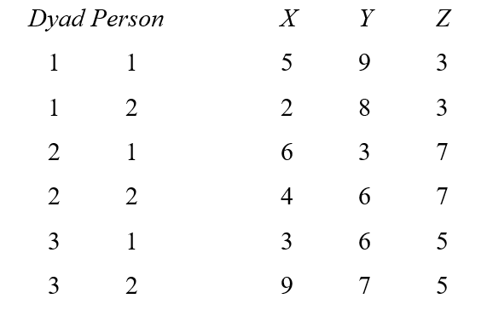
Illustration of Data Structures: Individual

Slide 21
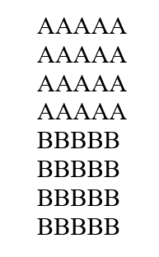
Illustration of Data Structures: Individual

Slide 22
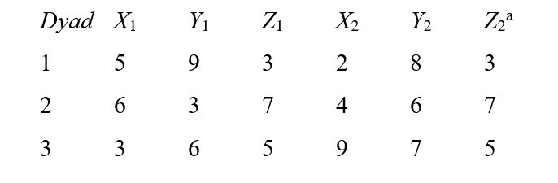
Illustration of Data Structures: Dyad

Slide 23
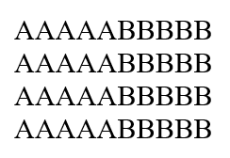
Illustration of Data Structures: Dyad

Slide 24
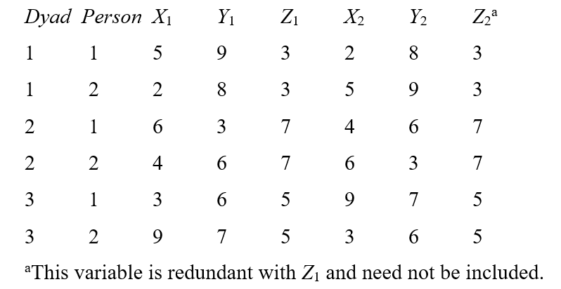
Illustration of Data Structures: Pairwise

Slide 25
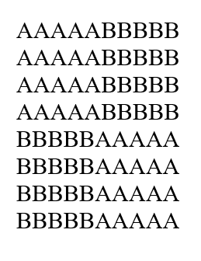
Illustration of Data Structures: Pairwise

Slide 26
R Demo
Then break! Then more demo…

Slide 27
Nonindependence in DYads

Slide 28
Negative Nonindependence
Nonindependence is often defined as the proportion of variance explained by the dyad (or group).
BUT, nonindependence can be negative…variance cannot!
This is super important
THE MOST IMPORTANT THING ABOUT DYADS!

Slide 29
How Might Negative Correlations Arise?
Examples
Division of labor: Dyad members assign one member to do one task and the other member to do another. For instance, the amount of housework done in the household may be negatively correlated.
Power: If one member is dominant, the other member is submissive. For example, self-objectification is negatively correlated in dyadic interactions.

Slide 30
Effect of Nonindependence
Consequences of ignoring clustering classic MLM
Effect Estimates Unbiased
For dyads especially
Standard Errors Biased
Sometimes too large
Sometimes too small
Sometimes hardly biased

Slide 31
Direction of Bias Depends on
Direction of Nonindependence
Positive
Negative
Is the predictor a between or within dyads variable? (or somewhere in between: mixed)

Slide 32
Effect of Ignoring Nonindependence on Significance Tests

Slide 33
What Not To Do!
Ignore it and treat individual as unit
Discard the data from one dyad member and analyze only one members’ data
Collect data from only one dyad member to avoid the problem
Treat the data as if they were from two samples (e.g., doing an analysis for husbands and a separate one for wives)
Presumes differences between genders (or whatever the distinguishing variable is)
Loss of power

Slide 34
What To Do
Consider both individual and dyad in one analysis!
Multilevel Modeling
Structural Equation Modeling

Slide 35
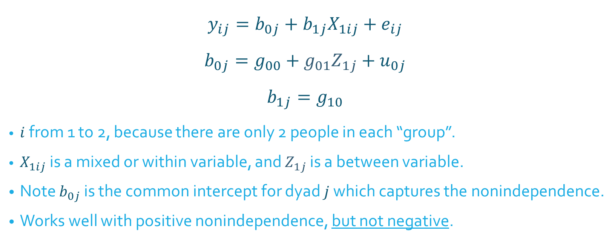
Traditional Model: Random Intercepts
$$y_{ij}=b_{0j}+b_{1j}X_{1ij}+e_{ij}$$
$$b_{0j}=g_{00}+g_{01}Z_{1j}+u_{0j}$$
$$b_{1j}=g_{10}$$
$i$ from 1 to 2, because there are only 2 people in each “group”.
$X_{1ij}$ is a mixed or within variable, and $Z_{1j}$ is a between variable.
Note $b_{0j}$ is the common intercept for dyad $j$ which captures the nonindependence.
Works well with positive nonindependence, but not negative.
Micro level
Macro level

Slide 36
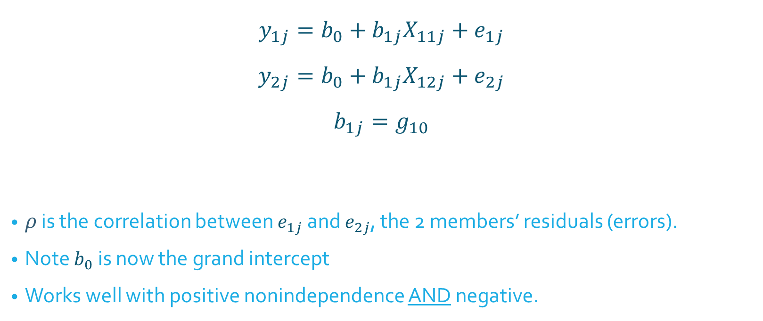

Alternative Model: Correlated Errors
$$y_{1j}=b_{0}+b_{1j}X_{11j}+e_{1j}$$
$$y_{2j}=b_{0}+b_{1j}X_{12j}+e_{2j}$$
$$b_{1j}=g_{10}$$
$ρ$ is the correlation between $e_{1j}$ and $e_{2j}$, the 2 members’ residuals (errors).
Note $b_{0}$ is now the grand intercept
Works well with positive nonindependence AND negative.
$ρ$ called “rho”
Micro level
Macro level

Slide 37
R Demo

Slide 38
Actor-Partner Interdependence Model (APIM)

Slide 39
Actor-Partner Interdependence Model (APIM)
A model that simultaneously estimates the effect of a person’s own variable (actor effect) and the effect of same variable but from the partner (partner effect) on an outcome variable
The actor and partner variables are the same variable from different persons.
All individuals are treated as actors and partners.

Slide 40
Data Requirements
Two variables, X and Y, and X causes or predicts Y
Both X and Y are mixed variables—both members of the dyad have scores on X and Y.
Example
Dyads, one a patient with a serious disease and other being the patient’s spouse. We are interested in the effects of depression on relationship quality

Slide 41
Actor Effect
Definition: The effect of a person’s X variable on that person’s Y variable
the effect of patients’ depression on patients’ quality of life
the effect of spouses’ depression on spouses’ quality of life
Both members of the dyad have an actor effect.

Slide 42
Partner Effect
Definition: The effect of a person’s partner’s X variable on the person’s Y variable
the effect of patients’ depression on spouses’ quality of life
the effect of spouses’ depression on patients’ quality of life
Both members of the dyad have a partner effect.

Slide 43
Distinguishability and the APIM
Distinguishable dyads
Two actor effects
An actor effect for patients and an actor effect for spouses
Two partner effects
A partner effect from spouses to patients and a partner effect from patients to spouses

Slide 44
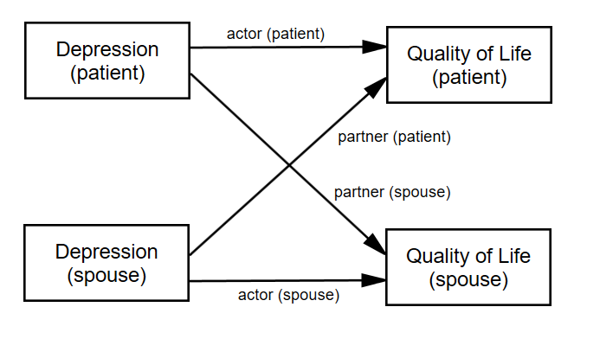
Distinguishable Dyads
Errors not pictured (but important)
The partner effect is fundamentally dyadic. A common convention is to refer to it by the outcome variable. Researcher should be clear!

Slide 45
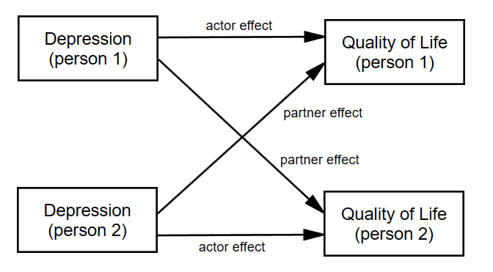
Indistinguishable Dyads
The two actor effects are set to be equal and the two partner effects are set to be equal.

Slide 46
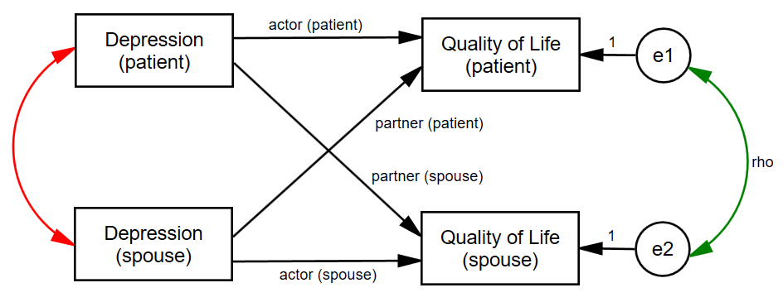
Nonindependence in the APIM
Green curved line: Nonindependence in Y
Red curved line: X as a mixed variable (r cannot be 1 or -1)
Note that the combination of actor and partner effects explain some of the nonindependence in the dyad.

Slide 47
R Demo

Slide 48
Test of Distinguishability

Slide 49
Test of Distinguishability
Advantages of Treating Dyad Members as Indistinguishable
Simpler model with fewer parameters
More power in tests of actor and partner effects
Disadvantages of Treating Dyad Members as Indistinguishable
If distinguishability makes a difference, then the model is wrong.
Sometimes the focus is on distinguishing variable and it is lost.
Some editors or reviewer will not allow you to do it.

Slide 50
Test of Distinguishability
Four ways that dyads can be distinguishable
Intercepts (main effect of distinguishing variable)
Actor effects
Partner effects
Error variances

Slide 51
Test of Distinguishability
Two runs:
Distinguishable (either interaction or two-intercept, results are the same)
Different Actor and Partner Effects
Main Effect of Distinguishing Factor
Heterogeneity of Variance (CSH)
Indistinguishable (4 fewer parameters)
Same Actor and Partner Effects
No Main Effect of Distinguishing Factor
Homogeneity of Variance (CSR)

Slide 52
Test of Distinguishability
Run using ML, not REML
Note the number of parameters
There should be 4 more than for the distinguishable run.
Note the -2LogLikelihood (deviance)
Subtract the deviances and number of parameters to get a χ² with 4df
Conclusion: If χ² is not significant, then the data are consistent with the null hypothesis that the dyad members are indistinguishable. If however, χ² is significant, then the data are inconsistent with the null hypothesis that the dyad members are indistinguishable (i.e., dyad members are distinguishable in some way).

Slide 53
R Demo

Slide 54
Binary and Count Outcome variables
Generalized Linear Mixed Models

Slide 55
Generalized Linear Models
In general we wrap the response variables in a link function (log, logit, probit, identity, etc.).
For example
A logistic regression is a generalized linear model making use of a logit link function.
A log-linear of Poisson regression is a generalized linear model making use of a log link function.
A regression model is a generalized linear model making use of an “identity” link function—the response is multiplied by 1.

Slide 56

Logistic Regression Review
DV is dichotomous
probability of belonging to group 1:$P_{1}$
probability of belonging to group 0: $P_{0}$ = $1−P_{1}$.
There are only two choices!

Slide 57
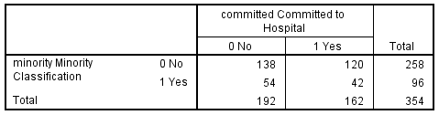
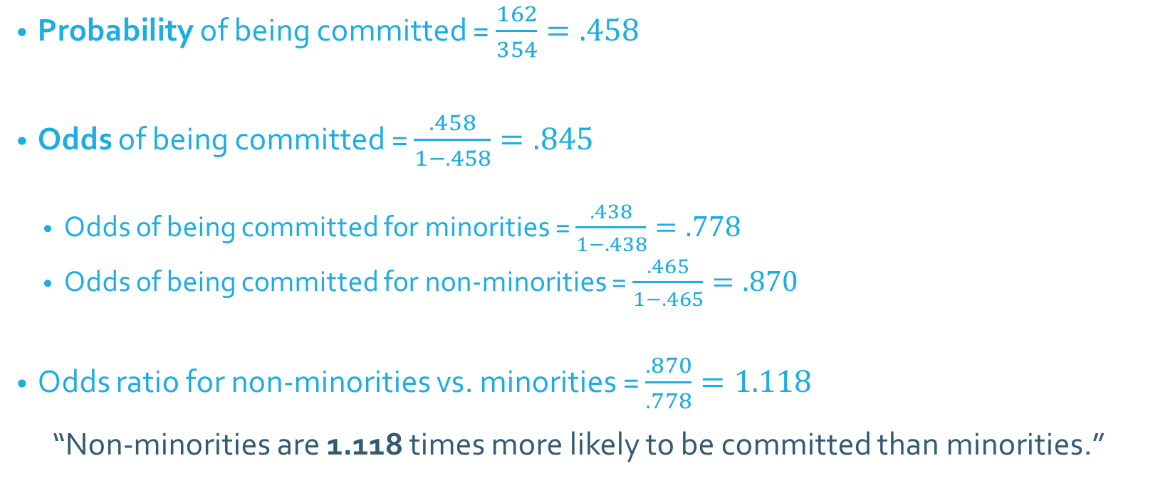
Odds and Odds Ratios
Probability of being committed = $\frac{162}{354}=.458$
Odds of being committed = $\frac{.458}{1−.458}=.845$
Odds of being committed for minorities = $\frac{.438}{1−.438}=.778$
Odds of being committed for non-minorities = $\frac{.465}{1−.465}=.870$
Odds ratio for non-minorities vs. minorities = $\frac{.870}{.778}=1.118$
“Non-minorities are 1.118 times more likely to be committed than minorities.”

Slide 58

Logistic Regression Equation
$$\ln\left(\frac{\hat{P_{1}}}{1−\hat{P_{1}}}\right)=b_{0}+b_{1}X_{1}+b_{2}X_{2}+…+b_{n}X_{n}$$
Where $\hat{P_{1}}$ is the predicted probability of being in group coded as 1
$\frac{\hat{P_{1}}}{1−\hat{P_{1}}}$ is the odds of being in group 1
$\ln\left(\frac{\hat{P_{1}}}{1−\hat{P_{1}}}\right)$ is the “logit” function

Slide 59
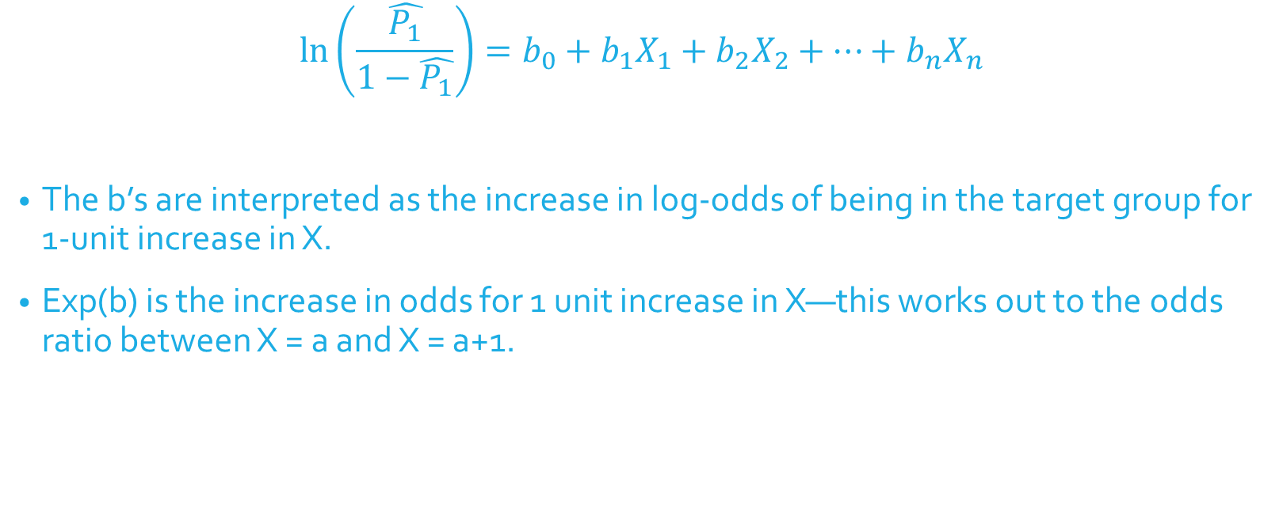
Logistic Regression Equation
$$\ln\left(\frac{\hat{P_{1}}}{1−\hat{P_{1}}}\right)=b_{0}+b_{1}X_{1}+b_{2}X_{2}+…+b_{n}X_{n}$$
The b’s are interpreted as the increase in log-odds of being in the target group for 1-unit increase in X.
Exp(b) is the increase in odds for 1 unit increase in X—this works out to the odds ratio between X = a and X = a+1.

Slide 60
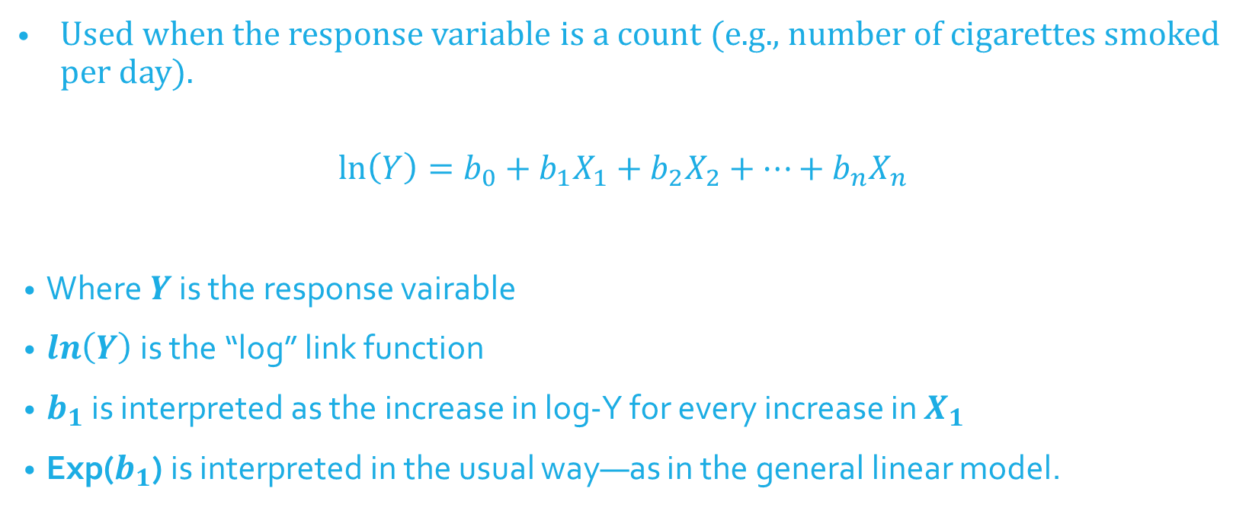
Log-Linear (Poisson) Regression Equation
Used when the response variable is a count (e.g., number of cigarettes smoked per day).
$$\ln\left(Y\right)=b_{0}+b_{1}X_{1}+b_{2}X_{2}+…+b_{n}X_{n}$$
Where$Y$ is the response vairable
$\ln\left(Y\right)$ is the “log” link function
$b_{1}$ is interpreted as the increase in log-Y for every increase in $X_{1}$
Exp($b_{1}$) is interpreted in the usual way—as in the general linear model.

Slide 61
Generalized Mixed Linear Models
Generalized linear models
In general we wrap the response in a link function (log, logit, probit, identity, etc.).
Generalized Mixed Linear Models
Do the same, include a link function that is appropriate for your response, but then include random effects in the model.
“Mixed” refers to the mixture of fixed and random effects in the model.
We’ll fit these models with the lme4 package in R, specifically, the glmer() function.

Slide 62
Generalized Estimating Equations (GEE)
Nonindependence treated as a “nuisance” to be removed; no statistical tests of nonindependence
Can be extended to:
Binomial outcome
Multinomial outcome (Categories: home/work/leisure)
Count data (Poisson, negative binomial)
Can also be used for continuous outcomes (normal distribution)
Fit these models with the gee package in R, specifically, the gee() function.

Slide 63
R Demo

Slide 64
Mediation

Slide 65
Mediation
c
X
Y

Slide 66
Mediation
M
a
b
c'
X
Y

Slide 67
The Four Paths
X → Y: path c
X → M: path a
M → Y (controlling for X): path b
X → Y (controlling for M): path c′

Slide 68
Decomposition of Effects
Total Effect = Direct Effect + Indirect Effect
c = c′ + ab
Note that
ab = c - c′
Percent of the total effect mediated:
ab/c *100
or
(1 - c′/c ) *100

Slide 69
Strategies to Test null hypothesis: ab = 0
Sobel test
Bootstrapping
Monte Carlo Method

Slide 70
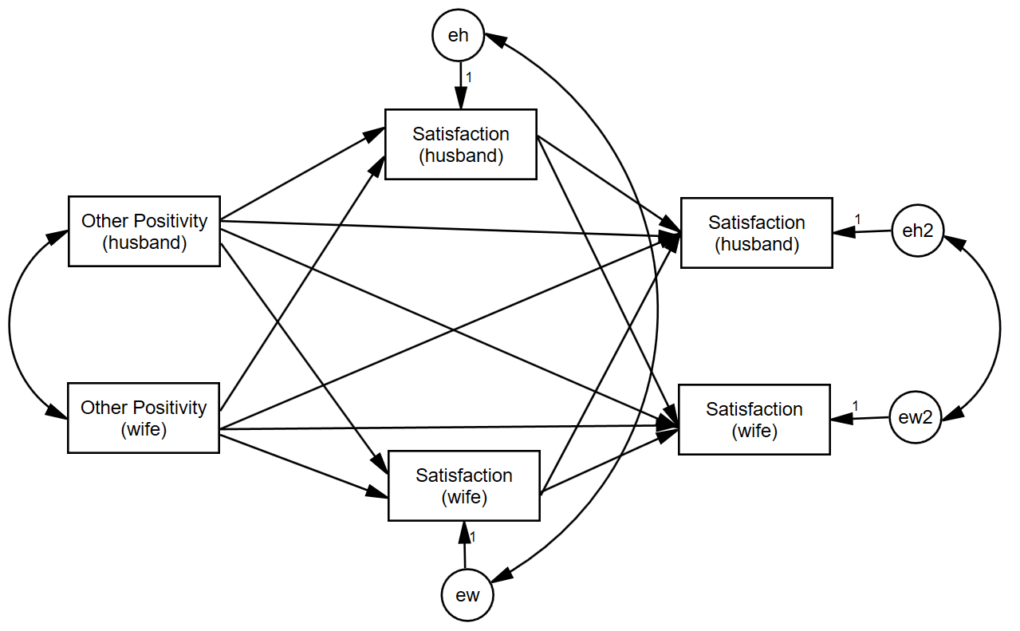
Example-Tension, Distinguishable

Slide 71
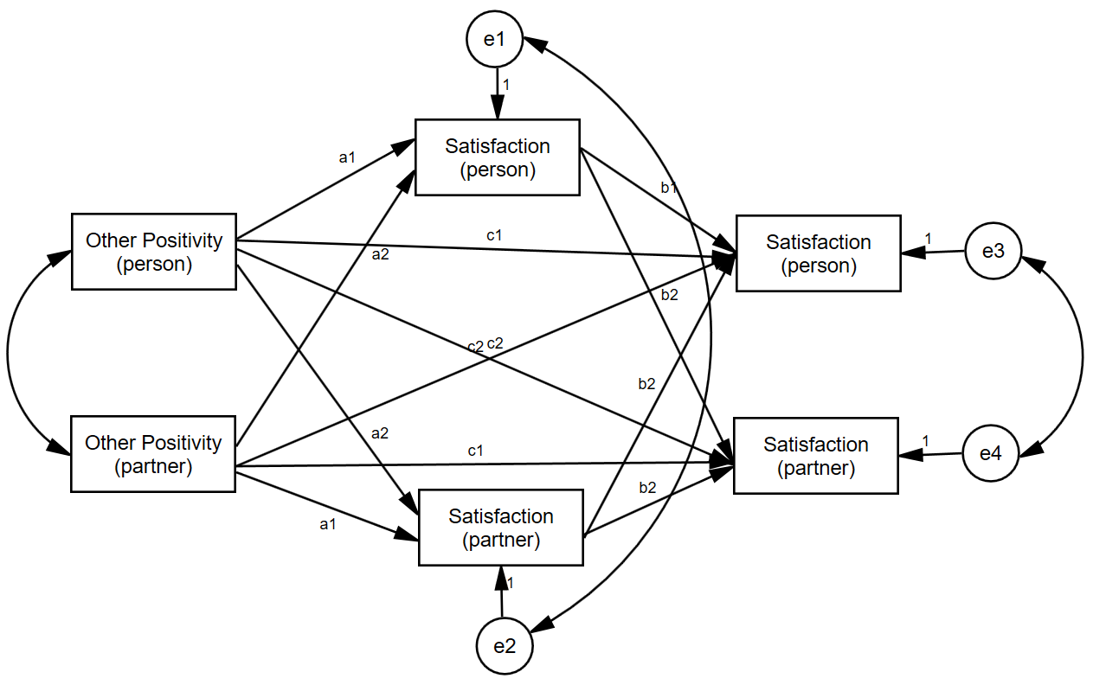
Example-Tension, Indistinguishable

Slide 72
R Demo

Slide 73
Moderation

Slide 74
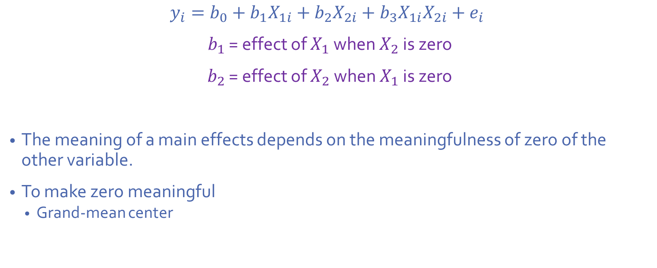
Centering Review
$$y_{i}=b_{0}+b_{1}X_{1i}+b_{2}X_{2i}+b_{3}X_{1i}X_{2i}+e_{i}$$
$b_{1}$ = effect of $X_{1}$ when $X_{2}$ is zero
$b_{2}$ = effect of $X_{2}$ when $X_{1}$ is zero
The meaning of a main effects depends on the meaningfulness of zero of the other variable.
To make zero meaningful
Grand-mean center

Slide 75
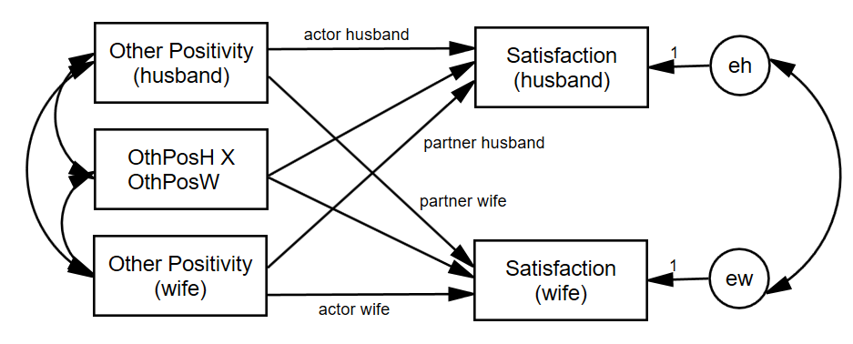
Actor-Partner Interactions
We can ask, does the actor effect get stronger or weaker as the partner variable goes up?

Slide 76
Dichotomous Within-Dyads Moderator
The distinguishing variable is a moderator.
The two partners each have a score but across dyads the average scores are the same (e.g., gender in heterosexual couples)
If dyad members are distinguishable, two moderation effects
Moderates the actor effect
Moderates the partner effect

Slide 77
Between-Dyads Moderator
One moderation variable (one score per dyad)
Examples
Years married
Couple level treatment
Gay vs. lesbian couples
Twins: separated at birth vs. raised together

Slide 78
Between-Dyads Moderator
Indistinguishable: Two moderation effects
Moderates the actor effect
Moderates the partner effect
Distinguishable: Four moderation effects
Moderates the actor effect for each member
Moderates the partner effect for each member

Slide 79
Mixed Moderator
The two partners each have a score, and the average score varies across dyads. Thus, there are really two moderator variables (actor and partner).
Indistinguishable: Four moderation effects
actor effect moderated by each member’s closeness
partner effect moderated by each member’s closeness
Distinguishable: Eight moderation effects
Each of the above also moderated by member type (e.g., husband and wife)
It would be great if we could simplify, find patterns among, these effects.

Slide 80
R Demo

Slide 81
Longitudinal Models

Slide 82
Examples of Over-Time Dyadic Data
Daily diary reports of relationship experiences from both members of heterosexual dating partners over 14 days
Repeated measures experiment where dyads interact with each other multiple times and make ratings after each interaction
Daily reports of closeness from both members of college roommate dyads

Slide 83
Basic Data Structure
The three-level nested myth: Time is nested within person and person is nested within dyad
Three-level nested only if the four time points differ such that T1a ≠ T1b, T2a ≠ T2b, etc.

Slide 84
Basic Data Structure
Dyad 1
In most cases the two dyad members are measured at the same time points, so Time is crossed with person.
Husband
Wife
T1
H_T1
W_T1
T2
H_T2
W_T2
T3
H_T3
W_T3
T4
H_T4
W_T4

Slide 85
Basic Data Structure
This two-level crossed structure results in an error structure in which the residuals may be correlated both
across dyad members
across time
H - Time 1
H - Time 2
H - Time 3
H - Time 4
Satisfaction
Satisfaction
Satisfaction
Satisfaction
eM1
eM2
eM3
em4
eF1
eF2
eF3
eF4
W - Time 1
W - Time 2
W - Time 3
W - Time 4
Satisfaction
Satisfaction
Satisfaction
Satisfaction

Slide 86
Types of Over-Time Models
Repeated Measures Model
Interest only in the effects of “time” across persons and dyads.
Growth Curve Model
Are there linear changes over time in the outcome variable?
Stability and Influence Model
Stability: Does Person A’s score at time 1 predict Person A’s score at time 2?
Influence: Does Person A’s score at time 1 predict Person B’s score at time 2?
Standard APIM
Different variables as the predictors and at the outcome
Does Variable 1 predict Variable 2?

Slide 87
Examples
Repeated Measures
The effect of day of the week (weekday versus weekend) and gender
Growth Curve Model
Individual growth curve
Dyadic growth curve
Satisfaction over time
Stability and Influence Model
Prior satisfaction predicts current satisfaction
Standard APIM
Actor and partner conflict predict satisfaction
Notes:
EDIT

Slide 88
Types of Variables
Time Invariant
Do not change over time
Measured at one time point only (typically the beginning of the study)
E.g., gender, attachment style, race
Time Varying
Measured at each time
E.g., daily mood, twice-weekly reports of friendship
Outcome variable must be time varying

Slide 89
How Many Time Points?
Depends on type of analysis
The more complicated the model, the more time points needed
Minimum
Repeated measures: Two
Other models: Three
More is better.
Ultimately depends on the model, the research setting, and research questions.

Slide 90
Example: Daily reports of conflict, support, and relationship satisfaction
Kashy data set
103 heterosexual dating couples
Assessed once daily for 14 days
Completed daily reports of relationship satisfaction and amount of conflict that day
Satisfaction and Conflict are time-varying
Pretest data for attachment avoidance
Measured for both people
Time invariant
Notes:
Only going to talk about satisfaction and attachment avoidance data
-back to kashy data

Slide 91
Person Period Pairwise Dataset
Each Person by Time combination has its own record
Person has its own variable (e.g., Person = 1, 2)
Occasion has its own variable (e.g., Day = 1 to 14)
Required for Multilevel Modeling
We’ll look at it when we get to R

Slide 92
Modeling Two Growth Curves
Y_{Wti} = c_{Wi} + b_{Wi}T_{ti} + e_{Wti}
Y_{Mti} = c_{Mi} + b_{Mi}T_{ti} + e_{Mti}
Intercepts
c_{Wi} = Predicted value of women’s satisfaction at study midpoint for dyad i
c_{Mi} = Predicted value of men’s satisfaction at study midpoint for dyad i
Slopes
b_{Wi} = Average change in women’s satisfaction over time for dyad i
b_{Mi} = Average change in men’s satisfaction over time for dyad I
Errors at each time point
Women = e_{Wti}
Men = e_{Mti}

Slide 93
Correlation of the Residuals
If the man reports more satisfaction for a particular day than would be expected given the overall effect of time, does the woman also report more satisfaction for that day?

Slide 94
Random Effects: Variances
There are six variances
two intercepts
Do men (and women) differ from each other in their “time zero” predicted score?
two slopes for time
Do the slopes for men (and women) differ?
two error (distance from the line) variances
Error variances (deviations from the slope) for men and women

Slide 95
Random Effects: Within Person Correlations
Man intercept-slope correlation
If a man is highly satisfied at the study midpoint, is his change in satisfaction steeper?
Woman intercept-slope correlation
If a woman is highly satisfied at the study midpoint, is her change in satisfaction steeper?
95
Notes:
95
Make these faint (they need to be in here but we aren’t going to talk about them)

Slide 96
Four Between-Person Correlations
Correlation of the intercepts between partners
Overall, do women who have higher levels of satisfaction at the study midpoint tend to have male partners who are also higher in satisfaction at the study midpoint?
That is: Is there a correspondence between level of satisfaction?
Correlation of the slopes
Do women whose satisfaction changes over time tend to have male partners whose satisfaction also changes over time?
That is: Is there a correspondence between linear change in satisfaction?
Two slope-intercept correlations
Do women with higher levels of satisfaction have male partners who increase or decrease?
Do men with higher levels of satisfaction have female partners who increase or decrease
Notes:
Do we want to keep all of this?
-lighten these up. Emphasize the first two (less the third)

Slide 97
Estimates of Random Effects
 |  | Man Intercept | Woman Intercept | Man Time Slope | Woman Time Slope
Man Intercept | sd
Woman Intercept | sd | r
Man Slope | sd | r | r
Woman Slope | sd | r | r | r
Residual | sd
Rho
The random option specifies the variances (given as standard deviations) and covariances (given as correlations) between the intercepts and slopes

Slide 98
Why Random Effects Are Important
If the wrong random model is selected (one that is too complicated), the solution may not converge.
If the wrong model is selected (one that is too simple), significance tests of fixed are wrong.
Standard errors are biased
They are interesting in their own right.
Answers interesting questions about individual differences and similarity of dyad members.
Points to possible moderators.
Can be combined with fixed effects for interpretation.

Slide 99
R Demo

Slide 100
Longitudinal APIM

Slide 101
Longitudinal APIM
This is old hat—but the random actor and partner effects are the most interesting!
Man’s Actor
Man’s Conflict
Man’s Satisfaction
W to M Partner
M to W Partner
Woman’s Conflict
Woman’s Satisfaction
Woman’s Actor

Slide 102
Data Structure
ID | Dyad | Partnum | Time | Actor Satis. | Actor Conflict | Partner Conflict
25 | 13 | 1 | 1 | 2 | 5 | 5
25 | 13 | 1 | 2 | 5 | 2 | 3
25 | 13 | 1 | 3 | 7 | 5 | 6
25 | 13 | 1 | 4 | 4 | 7 | 8
26 | 13 | 2 | 1 | 3 | 5 | 5
26 | 13 | 2 | 2 | 6 | 3 | 2
26 | 13 | 2 | 3 | 8 | 6 | 5
26 | 13 | 2 | 4 | 2 | 8 | 7

Slide 103
Stability and Influence
Notes:
AKA responsiveness (as to make it not so partner focused)

Slide 104
Stability-Influence: APIM
Man’s Satisfaction Yesterday
Man stability
Man’s Satisfaction Today
Woman influence
Man influence
Woman’s Satisfaction Yesterday
Woman’s Satisfaction Today
Woman stability
We can measure stability and influence for each man and each woman:
Is stability moderated by gender?
Is influence moderated by gender?

Slide 105
Data Structure
ID | DYADID | PERSON | DAY | ASATISF | ASATISF Lagged | PSATISF Lagged
25 | 13 | 1 | 1 | 2 | . | .
25 | 13 | 1 | 2 | 5 | 2 | 3
25 | 13 | 1 | 3 | 7 | 5 | 6
25 | 13 | 1 | 4 | 4 | 7 | 8
26 | 13 | 2 | 1 | 3 | . | .
26 | 13 | 2 | 2 | 6 | 3 | 2
26 | 13 | 2 | 3 | 8 | 6 | 5
26 | 13 | 2 | 4 | 2 | 8 | 7

Slide 106
R Demo

Slide 107
Common Fate Model

Slide 108
Dyadic Models
The Common Fate Model (CFM) is perhaps the oldest dyadic model (Kenny & La Voie, 1985).
However, CFM used empirically only a handful of times.
The APIM which is regularly used (at least 95% of the time) may often be theoretically inappropriate.
Paper: Ledermann, T., & Kenny, D. A. (2012). The common fate model for dyadic data: Variations of a theoretically important but underutilized model. Journal of Family Psychology, 26, 140‑148.
Notes:
108

Slide 109
The CFM as a SEM Model
The Common Fate Model (CFM) consists of 2 latent variables (X and Y) and 2 indicators (X_{A} and X_{B}, Y_{A} and Y_{B}) where A and B are distinguishable members of a dyad.
e₁
e₂
e₃
e₄
1
1
1
1
X_{A}
X_{B}
Y_{A}
Y_{B}
a
a
1
1
1
1
X
b
Y
1
r_{Y}
The model has 1 df.
That 1 df can be viewed as testing if the loading on X_{B} and Y_{B} are not equal to one. If fit is poor, the two loadings can be fixed to the same value.

Slide 110
Indistinguishable Members
Five equality constraints are made: equal X and Y intercepts, equal X and Y error variances, and equal error covariances.
e₁
e₂
e₃
e₄
1
1
1
1
X_{A}
X_{B}
Y_{A}
Y_{B}
1
1
1
1
X
b
Y
1
r_{Y}
With these constraints, the model has zero df.
Notes:
110

Slide 111
When Does the CFM Make Sense?
The latent variable represents a dyadic construct (“us,” “we,” or “the relationship” instead of “you” or “him or her”) or shared external influences.
The causal relation between the variables is presumed to be at the level of the dyad.

Slide 112
When Does the CFM Not Make Sense?
The variable measures an individual characteristic: how the individual feels or the individual’s personality.
The two dyad members scores correlate weakly with each other. If the correlation between the two X or Y scores is weak (r < .30), there can be estimation difficulties.

Slide 113
Advantages of the CFM over the APIM
Has a true “dyad-level” effect, not individual-level effects
Parsimony: For moderation and mediation in the APIM, there can be up to 8 effects. For the CFM, there is just one. Thus, the CFM is simpler.
Notes:
113

Slide 114
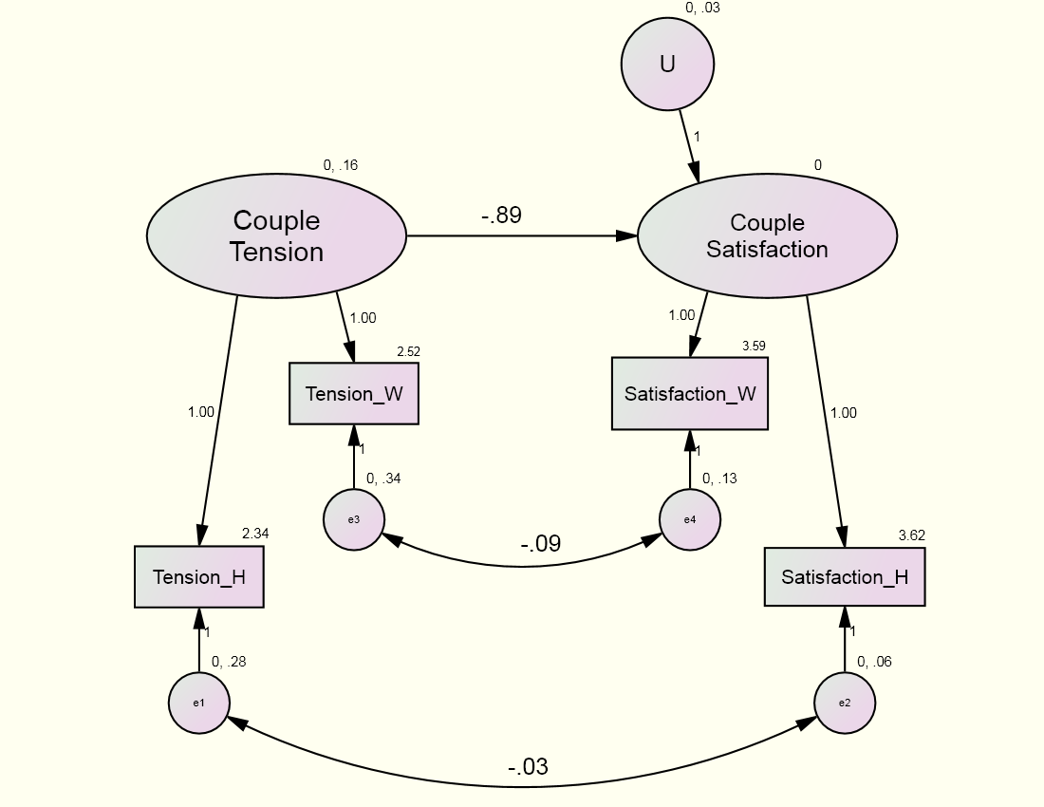
Example: Standard CFM
χ²(1) = 0.179, p = .672

Slide 115
R DEMO

Slide 116
(Current/Known) Limits of R
Indistinguishable dyads
Needs to be analyzed in SAS, HLM, or MLwiN because constraints on the variance-covariance matrix or random effects are needed.
P-values for random effects

Slide 117
Topics Not Covered
Indistinguishable dyads
Time-varying moderators
E.g., daily mood moderates daily satisfaction
Non-linear growth curve models
Transformations
Periodic effects
Cubic, quadratic
More complicated error models
Longitudinal models with non-normal outcomes—but glmer() can handle them

Slide 118
Bonus: Common fate growth model

Slide 119
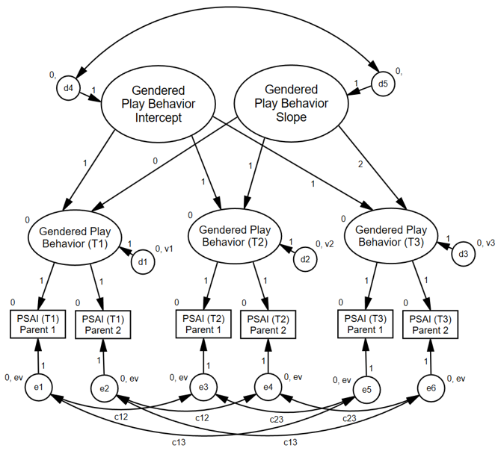
Children’s Gendered Behavior Overtime
Goldberg & Garcia (2016)

Slide 120
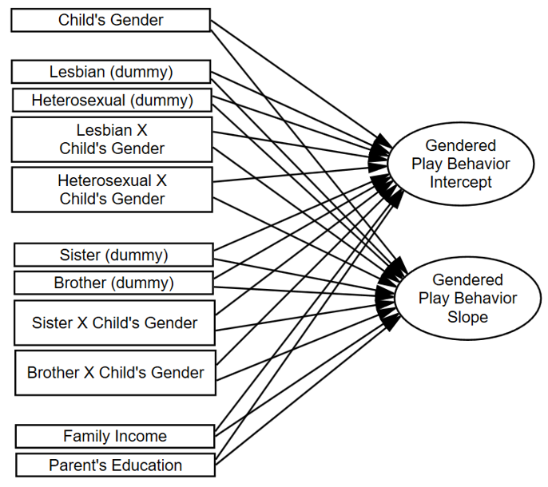
Children’s Gendered Behavior Overtime

Slide 121
Bonus: Other SEM dyad models

Slide 122
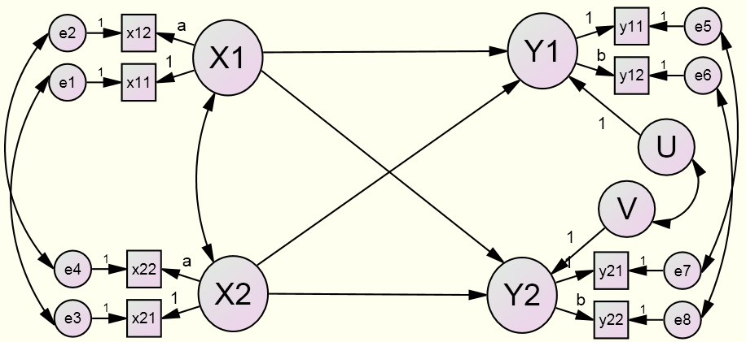
Latent Variable APIM
Advantages over Traditional APIM
Effects may be larger.
Effects are less biased.

Slide 123
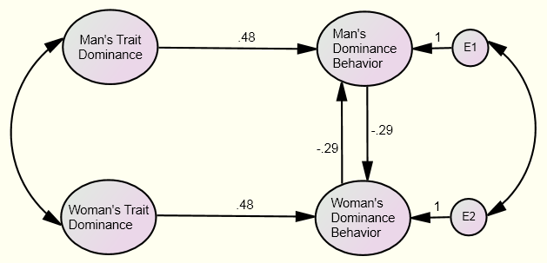
The Mutual Influence Model

